Slide 1


FACIAL EMOTION RECOGNITION USING ML ALGORITHMS
Review - III
Date: 28 May 2021
V.V.S.S.RAMYA : 17WH1A0501
AFRAH SAMREEN : 17WH1A0526
SK.AFIFA RESHMA : 17WH1A0535
Internal Guide: Mr. U.CHANDRASEKHAR
Designation: Associate Professor
Department of Computer Science & Engineering
BVRIT HYDERABAD College of Engineering for Women

Slide 2
Abstract
Why Should I Study this course?
Facial expressions are the vital identifiers for human feelings because it corresponds to the emotions.
The facial expressions are mostly a non-verbal way of emotional expression.
It can be considered as concrete evidence to uncover whether an individual is speaking the truth or not.
The dataset consists of 35,887 images.​
The dataset focuses on seven essential facial expression which are happy, sad, surprise, fear, neutral, disgust and anger.
The classification of the facial expressions are performed using Convolutional Neural Network and Haar Cascade Classifier Algorithm.
Accuracy obtained is 60.30%. The accuracy is found to be improving if the variance among the data of different classes is high.
Examples
BVRIT HYDERABAD College of Engineering for Women

Slide 3
Why Should I Study this course?
Applications:-
Facial Emotion Recognition is essential to recognize the emotions in many cases like in criminal investigation, E-learning, gaming and psychology.
In criminal investigation, it is used to identify the criminals based on their facial expressions.
Similarly in E-learning, this can be used to conclude whether a student is understanding the concept or not .
In other applications it ensures the understanding of a person’s emotional condition.
Examples
BVRIT HYDERABAD College of Engineering for Women

Slide 4
Block Diagram
Data Acquisition
Data Preprocessing
Model Creation
Output
Classification
Input image
Training and
Accuracy

Slide 5
Technology Stack
Machine Learning
Python Programming Language
Colab
Runtime- GPU
Required Packages :
numpy
pandas
keras
sklearn
seaborn
matplotlib
Scikitplot
cv2
BVRIT HYDERABAD College of Engineering for Women

Slide 6
Output
Accuracy of our model is 60.30%
Emotions detected:
Happy
Sad
Fear
Disgust
Surprise
Anger
Neutral
Algorithms used are Convolutional Neural Networks(CNN) and Haar Cascade classifier.
Haar Cascade classifier is an effective object detection approach used for boosting. It is used for face identification in the image.
BVRIT HYDERABAD College of Engineering for Women

Slide 7
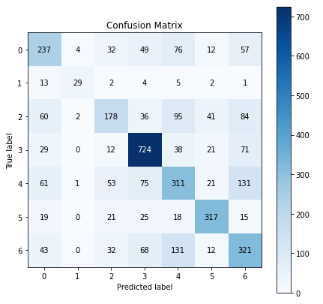
Confusion Matrix
0 – Anger
1 – Disgust
2 – Fear
3 – Happy
4 – Sad
5 – Surprise
6 – Neutral
BVRIT HYDERABAD College of Engineering for Women

Slide 8
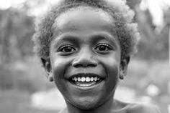


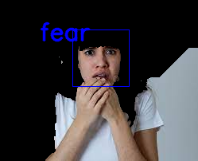
Test Cases
BVRIT HYDERABAD College of Engineering for Women

Slide 9
Thank you
BVRIT HYDERABAD College of Engineering for Women

